Slide 1
TEACHmi - TEACHER PREPARATION FOR
MIGRANT SCHOOL INCLUSION
PROJECT NUMBER – 612216-EPP-1-2019-1-EL-EPPKA3-IPI-SOC-IN AGREEMENT NUMBER – 612216

Slide 2
INCLUSIVE MULTICULTURAL CLASSROOM

Slide 3
Specific objectives | To improve the knowledge and skills to introduce innovative practices in the multicultural educational environment, contributing to the inclusion of students from different ethnic backgrounds, including migrants and their educational integration. To learn specific techniques of pedagogical interaction, taking into account the culture of learning and behavior of students from different ethnic backgrounds, including Migrant..
Expected learning outcomes | Using effective pedagogical approaches based on cooperative learning to project-oriented learning, thereby stimulating teamwork, cooperation, respect in the multicultural educational environment. Introducing practical working patterns oriented towards managing student behaviour and ensuring tolerance and respect for democratic principles. Organization and management of educational spaces to provide each student with the attitude that the territory of the classroom is also its territory.
Basic concepts | Multicultural educational environment; inclusive educational environment; learning based on cooperation; conflict resolution

Slide 4
A set of factors and conditions
constituting that significant for
each student environment in which
carry out his upbringing,
education and formation as a person.
EDUCATIONAL ENVIRONMENT
MULTICULTURAL EDUCATIONAL ENVIRONMENT
INCLUSIVE EDUCATIONAL ENVIRONMENT
INCLUSIVE MULTICULTURAL EDUCATIONAL ENVIRONMENT
Educational environment in which they are brought up,
train and socialize students with different
ethnic / cultural affiliation.
Educational environment that takes into account
the needs of each student based
of its individual features -
level of development, abilities,
cultural, social and other differences.

Slide 5
INCLUSIVE MULTICULTURAL EDUCATIONAL ENVIRONMENT
Educational environment oriented to the student's personality. Each student is valued for their individuality and culture.
Educational space in which pedagogical approaches are applied, recognizing and taking into account the specifics of cultural diversity.
A safe and secure environment that provides conditions for each student to feel protected and free to develop their abilities.
An environment dominated by respect, understanding and tolerance and fostering teamwork and cooperation.

Slide 6
EXAMPLES
The causes of certain educational deficits, problems with communication and the level of motivation and learning needs are investigated and identified.
Programs are developed and implemented for additional support for students who have problems with language acquisition, resp. with learning; methods are used to increase motivation and to overcome communication problems.
Curriculum design is developed and learning technologies are used in accordance with the diversity of cultures.
Various projects for intercultural communication are developed and implemented - in the classroom and in extracurricular activities.

Slide 7
Organization of an inclusive multicultural educational environment
The competent teacher organizes the environment, taking into account and taking into account the cultural diversity in the classroom.
The organization of the learning space is an important element of the management of the inclusive educational environment.
The competent teacher encourages the participation of students in organizing the learning space in the classroom.
A space (corner, exhibition) is provided in which students can arrange objects, symbols and materials related to the culture and traditions of their community.
The environment should bring peace and security, to create a feeling in the student that he is part of his personal space.
The interior is tailored to the age of the students. Opportunities are provided for providing learning resources to help students in the learning process.

Slide 8
Effective technologies for building inclusive
multicultural educational environment
Collaborative learning
A basic approach in building relationships typical of an inclusive multicultural educational environment.
Respect for the individual
Respect for different opinions
Partnership, teamwork
Empathy
Emotion management
Behavior control in extreme situations
Socially responsible behavior towards others and towards oneself
It is based on the idea of ​​equality and partnerships between all participants in solving the set training tasks.
Success in solving tasks depends on good communication, constructive ideas of each participant and teamwork.
Leading is the understanding that the team represents
a cohesive group whose members interact for the achievement of a specific goal and strive to achieve an effective result.

Slide 9
Effective technologies for building inclusive
multicultural educational environment
Cooperative learning
A variety of collaborative learning, which is working together and joining forces to solve a common task, but each of the "cooperators" performs a certain part of the work, important enough and responsible for a successful end result.
Problem-based learning
Learning focused on the acquisition of new knowledge by solving a problem. It requires activity and independence on the part of students, creativity, combinability and cooperation between them.
Project-based learning
Personality-oriented technology for organizing the independent activity of students, integrating the problem approach, group work, research methods. Training aimed at developing initiative, creativity, research skills by solving interesting tasks or problems for students, mainly of a practical nature. It involves self-organization and self-management of the team, which stimulates teamwork and cooperation.

Slide 10
Specific strategies, stimulating active learning and positive behavior in the inclusive multicultural classroom
Focus attention. This is done by giving meaning to students' activities and experiences through clear explanations of consequences and causes.
Redirection. It is a change in students' activity, targeting another activity by means that can cause awareness of the reason for redirection.
Negotiation. It is an arrangement between the teacher and an individual student or several students regarding the performance of or abstinence from certain actions, procedures, duties and consequences for a period of time specified by both parties. It is effective as a technique for preventing unwanted behavior.
Ignore. Systematic and demonstrative ignorance of mismatched student behavior.
Stimulation of certain group dynamics processes. It can include demonstrating attention to a particular student, organizing situations that provoke suspicion of prejudices, and more.
Development of standards of conduct– individual standards, class charter, rules for the conduct of individual activities or events.

Slide 11
Conflict management in an inclusive multicultural educational environment
Conflicts - an integral part of public relations. They are defined as a conflict of incompatible interests, manifested in hostile actions of verbal and non-verbal nature.
The multicultural classroom, as a place where different cultures and different types of worldviews meet, is a natural space where conflicts often arise..
TYPES OF CONFLICTS
Positional | At least one of the parties or both parties actively defend their interests, declare their positions from the very beginning and firmly defend them to the end. | worsen relationships polarize positions do not disclose well enough interests exclude opportunities and other alternatives to solution
Constructive | There is a desire to take into account the interests of the various parties to the conflict and a willingness to negotiate and compromise. | he interests and desires of the parties are openly stated; trust is created between the parties; good relationships are achieved; compromise solutions are being sought

Slide 12
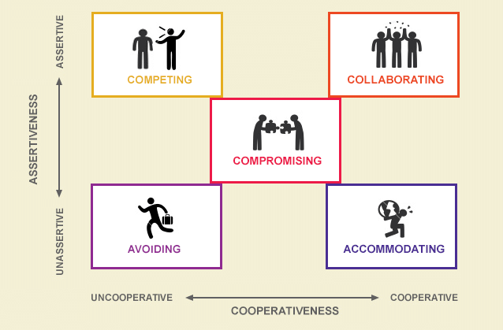
Conflict management in an inclusive multicultural educational environment
Conflict management styles
Avoiding
Rivalry
Cooperation
Adaptation
Compromise

Slide 13
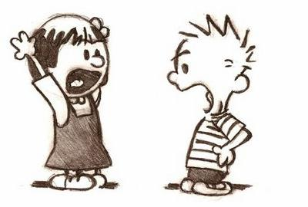
Conflict management in an inclusive multicultural educational environment
Successful conflict management means not only the ability to manage conflicts that have already arisen, but also to prevent them from happening.
These skills are related to the knowledge of the cultural specifics of students and their behavior, as well as the mastery of techniques for dealing with such situations.
Effective conflict management techniques in an inclusive multicultural classroom
Careful listening of the parties, demonstrating active listening by asking appropriate questions, paraphrasing, summarizing information.
Demonstrate calmness and patience in the conversation, as well as attention to the parties in order to reduce tensions.
Striving to recognize and understand the "hidden meaning" of words as well as body language in the context of culturally defined patterns of behavior.
Demonstration of sustainability and impairability, use of persuasion techniques.
Sharing and discussing with the parties constructive proposals, ideas and possible solutions to the situation.
https://bg.stuklopechat.com/

Slide 14
Summary…
An inclusive multicultural learning environment is not just a classroom. It is a combination of many conditions and factors that create space for learning, development and socialization of all students, incl. and those with a migrant background, taking into account and striving to meet their individual needs.
In an inclusive multicultural educational environment, cultural diversity is valued and respected, and every student, regardless of their background, is supported and stimulated through their development.
In the inclusive multicultural educational environment, pedagogical approaches and technologies are used, which contribute to easier adaptation to the new environment for the student and support him in the educational process.
In an inclusive multicultural educational environment, respect, cooperation, teamwork and trust between students are encouraged and tolerated. Avoiding or overcoming ethnocultural conflicts is an important priority in managing a multicultural classroom.

Slide 15
Sources
Бузов, Е. Четирите стени на училището, София, 2007
Бузов, Е. Мениджмънт на занималнята и класната стая, София, 2004
Иванов, Ив. Мениджмънт на ученическия клас. Шумен, 2005
Иванов, Ив. Проблеми на педагогическата работа в мултикултурната класна стая. - В: Многообразие без граници, В. Търново, 2008
Тодорина, Д. Мениджмънт на класа. УИ „Неофит Рилски“, Благоевград, 2005
Тоцева, Я., Й. Нунев. Педагогически взаимодействия в мултикултурна среда. В. , Търново, 2019
Everard, K.B.,G. Morris. Effective School Management, third edition, Paul Chapman Publishing Ltd, London,1996
Hedley, I. Managing behaviour with classroom charters – Support for Learning, 1999, Vol. 14, No 3

