Slide 1
TEACHmi - TEACHER PREPARATION FOR
MIGRANT SCHOOL INCLUSION
PROJECT NUMBER – 612216-EPP-1-2019-1-EL-EPPKA3-IPI-SOC-IN AGREEMENT NUMBER – 612216

Slide 2
OVERCOMING STEREOTYPES AND PREJUDICE AND
FORMATION CULTURAL AWARENESS

Slide 3
Specific objectives | Understanding the problem of stereotypes, prejudices and discrimination and learning techniques and technologies to overcome them Awareness of the value of cultures and formation of positive attitudes in a situation of intercultural interaction Building engaged behavior in an intercultural interaction situation
Expected learning outcomes | Identification of social, cultural and socio-psychological factors underlying the formation of stereotypes and prejudices Development of self-reflexive attitudes regarding own cultural identity and in interaction with other cultures
Basic concepts | Stereotypes; prejudice; racism; discrimination; ethnocentrism; cultural relativism; cultural sensitivities; cultural awareness

Slide 4
Theoretical definitions
Stereotype
A schematic, sustainable, standard of perception, presentation, thinking and behavior of the person or social group/community
A simpled set of descriptive components for a group of people who are believed to have common characteristics.
A generally accepted naïve definition of a group of people, without taking into account the individual differences between the members of this group.
ETHNIC STEREOTYPES
Collective ideas, forming certain norms of behavior in relation to one or another group and their representatives. The specificity of the stereotype is that the qualities inherent in one or another member of an ethnic group are transferred to the whole group.

Slide 5
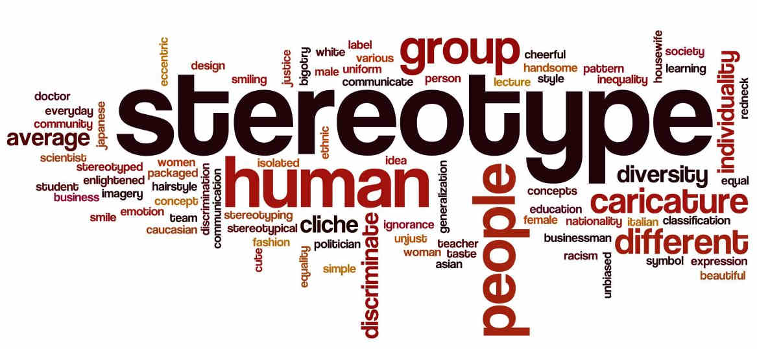
EXAMPLES
The Japanese are:
friendly
hardworking
disciplined
Blacks are the best athletes.
Southern nations are lazy.
The England people:
cold
conservative
aristocrats

Slide 6
Theoretical definitions
PREJUDICE
Personal opinion formed on the basis of insufficient information and hasty summaries; preconceived negative attitude towards something or someone (usually unfair).
STIGMATIZATION
Strong public disapproval; stigmatization,
sharp condemnation for some characteristic,
which makes a person or group unwanted
for communication.

Slide 7
Theoretical definitions
PREJUDICE
An attitude towards a person or group of people that is not based on any experience or experience, but only on a stereotype.
Judgments based more on negative generalizations and stereotypes than on facts, cases or certain behavior of individuals or groups.
Pre-negative assessment for members of a group on racial, religious, ethnic or / and other signs.
Antipathy based on an erroneous summary of a group to which undesirable qualities are attributed.

Slide 8
EXAMPLES
Migrants cannot be integrated.
The gypsies are:
uneducated
thieves
poor
dirty
All muslims are fanatics.
People with disabilities are not valuable.
The black race is inferior than the rest.

Slide 9
Theoretical Definition
PREJUDICE / STEREOTYPES
ETHNOCENTRISM
RACISM
XENOPHOBIA
A sense of superiority of one's own culture
above others. Attitude to value other cultures
and the conduct of their representatives during
the prism of one's own culture.
Hatred, hostility directed
foreigners and everything foreign.
Hatred of foreigners. Conviction,
that "foreigners" will harm society.
A belief system that identifies minorities or certain ethnic groups as inferior and puts them in a subordinate position.

Slide 10
Theoretical definitions
RACISM
Inequality of race and ethnic groups is not limited to individual acts of discrimination, but affects the work of institutions such as school, police, court, which approach the person according to his ethnicity.
Racism and discrimination most often occur at the institutional level.
DISCRIMINATION
Any conduct based on differences made on the basis of ethnic or social affiliation, which depends neither on individual abilities, qualities or merits, nor on the specific behavior of the individual.
Exclusion of a person or group of social privileges and actions.

Slide 11
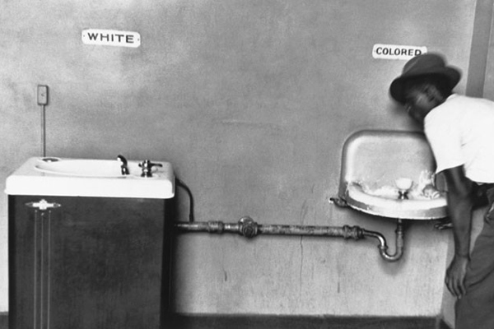
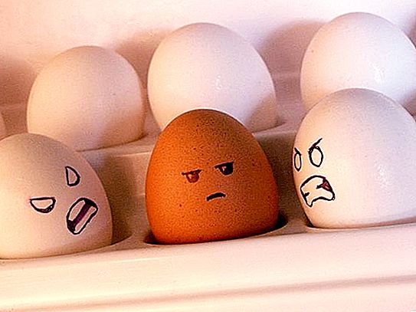
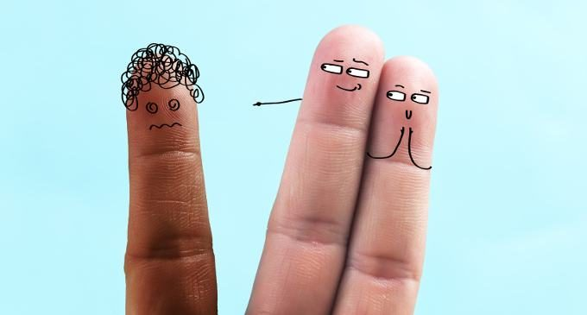
EXAMPLES
Our school educates mainly local students.
We do not have the practice of enrolling migrant students.
You meet all the criteria for the position,
but you can't be appointed - how will you
the parents accept a teacher who is from the minorities?!?
https://www.webmiastoto.com/
https://agromassidayu.com/
https://www.akoaypilipino.eu/

Slide 12
REASONS
Social inequalities
STEREOTYPES
MANIFESTATION
Insults, threats
Stereotypical attitudes
Ethnic differences
Ignorance of cultural and other specifics
Prejudice
Stigmatization
Intolerance
Ethnocentrism
Racism
Aggression
Brake
Violence
Discrimination

Slide 13
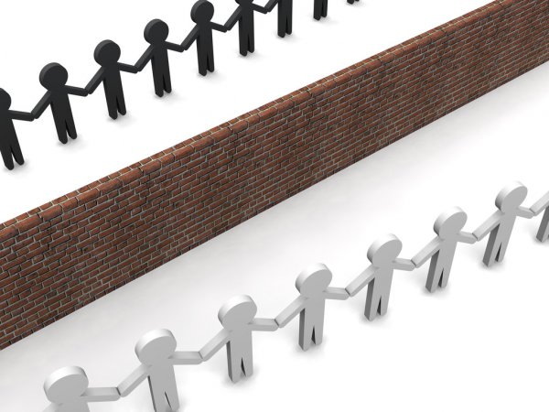
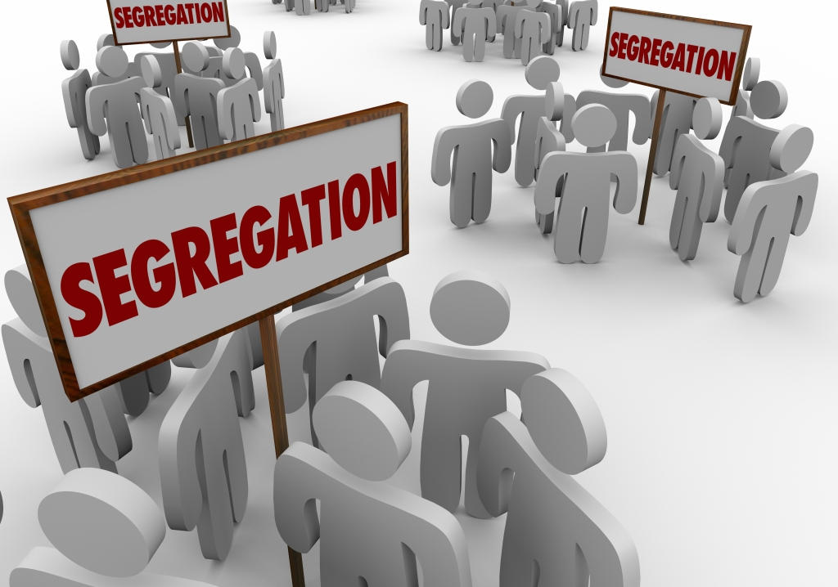
PREJUDICE
SOCIAL DISTANCE
SOCIAL ISOLATION
SEGREGATION

Slide 14
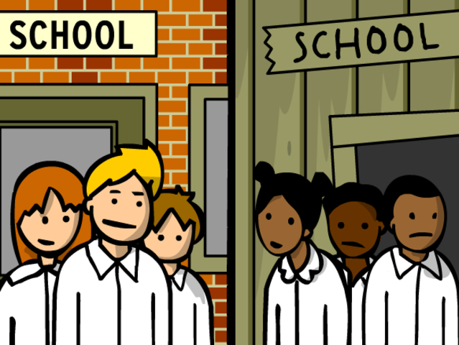
SEGREGATION - a form of discrimination; institutional practice of dividing people most often on ethnic grounds.
Segregation is most evident in the field of education.
Examples:
Establishment of kindergartens and schools, in which only children and students are educated and trained with a different ethnic background from that of the majority.
Separation of areas / neighborhoods where they live alone people from certain ethnic minorities isolated from the community of the city and the majority.
https://www.timetoast.com/

Slide 15
Theoretical definitions
INTERCULTURALITY
Interconnection of cultures, dialogue and interaction between them;
Communication and exchange of values ​​between the representatives of different cultures on the basis of cultural relativism;
Characteristics of modern society, affirming the need for positive contacts between groups and individuals and suggesting the exchange of values.
CULTURAL RELATIVISM
Recognition of the equivalence of each culture;
Getting to know, understand and accept the different culture and its carriers;
Positive attitude and interaction with culturally diverse people;
Mutual cultural enrichment and cooperation.

Slide 16
CULTURAL
SENSITIVITY
 active curiosity about other cultures;
 analysis and acceptance of cultural differences;
 overcoming prejudices;
 assessment of one's own culture and readiness for intercultural cooperation
CULTURAL
AWARENESS
 set of knowledge about cultural differences;
 abilities to realize the value of mutual enrichment resulting from positive intercultural interactions;
 knowledge of the action of various factors determining the formation of stereotypes and prejudices
INTERCULTURAL
COMPETENCE
Complex of:
 knowledge of one's own and other cultures and their carriers;
 skills for easy and effective communication and interaction with representatives of different cultures;
 positive attitudes and attitudes towards the different culture and its bearers, based on respect and tolerance.

Slide 17
DMIS Developmental Model of Intercultural Sensitivity (M. Bennett)
Denial
differences
Adaptation of differences
Integration of the differences
Protection against
differences
Minimization
of the differences
Accepting of
differences
ETHNORELLATIVE STAGE
ETHNOCENTRIC STAGE
Denial of differences | Characteristic features are isolation and separation.
Protection against differences | Negative stereotyping, superiority and striving to overcome ethnocentrism.
Minimize differences | Striving to universalize cultural differences on the basis of similarities.
Acceptance of differences | Acceptance and respect for different behaviors and different values.
Adaptation of differences | Expression of empathy and striving to assess the difference from the view of the "other".
Integration of differences | Ability to analyze and evaluate situations in an intercultural context.

Slide 18
EXAMPLES
ETHNOCENTRIC STAGE
Denial of differences
We do not allow our children to communicate and play with the children of migrant families living in the nearby apartment building. We don't know them at all, they are very suspicious.
Protection against differences
They dress strangely, especially women, their language is incomprehensible. They often get together with other people in their community. They are Muslims and probably have contacts with suspicious radical groups.
Minimize differences
Migrant neighbors are respectful and friendly when we meet on the street. Their children attend school and quickly get used to our way of life.

Slide 19
EXAMPLES
ETHNORELLATIVE STAGE
Acceptance of differences
We are used to the presence of migrant neighbors. We are on good terms. They respect the culture and respect their traditions without imposing them on others. They respect our rules and way of life.
Adaptation to differences
Our children get along well with the children of migrants. They go to school together. Our children help them when they have difficulty with lessons.
Integration of differences
We accept migrant neighbors as part of our community, in our neighborhood.

Slide 20
Summary…
Cultural diversity is a prerequisite for the existence of stereotypes and prejudices.
Prejudices - such as judgments based on misconceptions and poor knowledge of cultural characteristics - distort the image of the "other" and often generate negative attitudes and behavior towards him - hate speech, aggression, stigma, discrimination…
The presence of stereotypes and prejudices is an obstacle to the successful integration - educational and social - of people of different ethnic backgrounds.
For teachers working with students of different ethnic backgrounds (incl migrants), understanding their own attitudes and behavior in an intercultural context is a necessary condition for achieving quality and professionalism in pedagogical interactions.
The intercultural competence of the teacher is a key factor for the successful integration of culturally diverse students in the inclusive classroom and for the formation of all future adults of attitudes and behavior in a spirit of understanding and respect for different cultures and their bearers.

Slide 21
Sources
Бузов, Е. Интеркултурното образование в мултикултурна училищна среда. – Многообразие без граници. В. Търново: Фабер, 2008
Здравкова, Б. Професионална компетентност на социалния педагог – нормативи, теория и практика. В. Търново, 2015
Нунев, Й. Мониторинг на процесите на приобщаване и образователна интеграция и и модели за десегрегация на ромското образование. Изд. „Астарта“, 2020
Тоцева, Я., Й. Нунев. Педагогически взаимодействия в мултикултурна среда. В. , Търново, 2019
Чавдарова-Костова, С. Съвременни предизвикателства пред интеркултурното възпитание. ИК “Образование”, София, 2010
Bennett, M. Tawards a Developmental Model of Intercultural Sensitivity. 1993 – http://www.library.wisc.edu/EDVRC/docs/public/ pdfs/.../intCulSens.pdf
Bennett, M., J. Bennett. Developing Intercultural Sensitivity: An Integrative Approach to Global and Domestic Diversity – http://www.diversitycollegiom.org/ pdf2001/2001Bennettspaper.pdf

